Slide 1
LOGISTIC REGRESSION

Slide 2
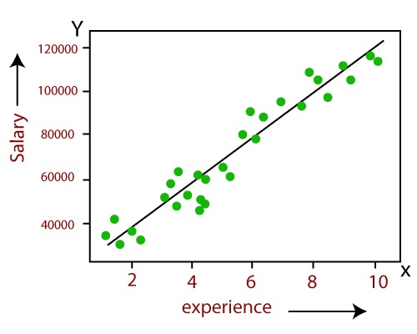
LINEAR REGRESSION
Linear Regression is one of the most simple Machine learning algorithm that comes under Supervised Learning technique and used for solving regression problems. It is used for predicting the continuous dependent variable with the help of independent variables. The goal of the Linear regression is to find the best fit line that can accurately predict the output for the continuous dependent variable.

Slide 3
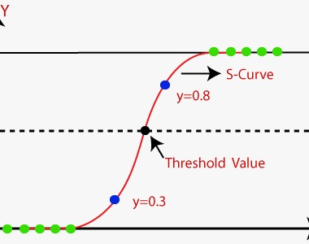
LOGISTIC REGRESSION
Logistic regression is one of the most popular Machine Learning algorithms, which comes under the Supervised Learning technique. It is used for predicting the categorical dependent variable using a given set of independent variables.Logistic regression predicts the output of a categorical dependent variable. Therefore the outcome must be a categorical or discrete value. It can be either Yes or No, 0 or 1, true or False, etc. but instead of giving the exact value as 0 and 1, it gives the probabilistic values which lie between 0 and 1.

Slide 4
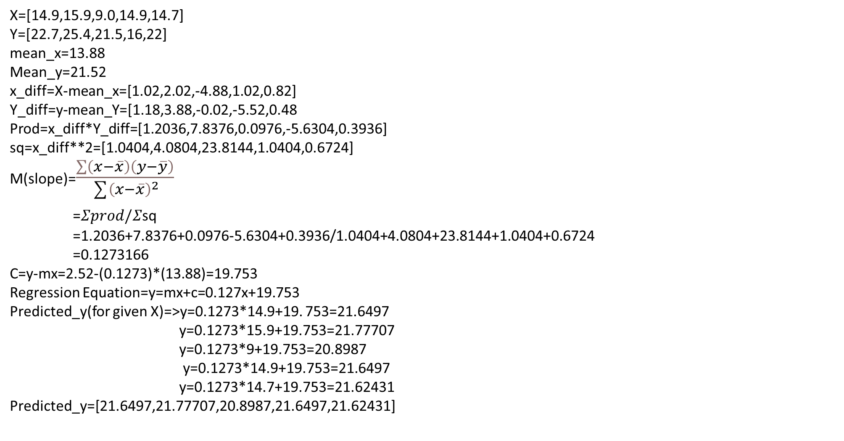
X=[14.9,15.9,9.0,14.9,14.7]
Y=[22.7,25.4,21.5,16,22]
mean_x=13.88
Mean_y=21.52
x_diff=X-mean_x=[1.02,2.02,-4.88,1.02,0.82]
Y_diff=y-mean_Y=[1.18,3.88,-0.02,-5.52,0.48
Prod=x_diff*Y_diff=[1.2036,7.8376,0.0976,-5.6304,0.3936]
sq=x_diff**2=[1.0404,4.0804,23.8144,1.0404,0.6724]
M(slope)=$\frac{\sum{\left(x−\overline{x}\right)\left(y−\overline{y}\right)}}{\sum{{\left(x−\overline{x}\right)}^{2}}}$
=$Σprod/Σ$sq
=1.2036+7.8376+0.0976-5.6304+0.3936/1.0404+4.0804+23.8144+1.0404+0.6724
=0.1273166
C=y-mx=2.52-(0.1273)*(13.88)=19.753
Regression Equation=y=mx+c=0.127x+19.753
Predicted_y(for given X)=>y=0.1273*14.9+19. 753=21.6497
y=0.1273*15.9+19.753=21.77707
y=0.1273*9+19.753=20.8987
y=0.1273*14.9+19.753=21.6497
y=0.1273*14.7+19.753=21.62431
Predicted_y=[21.6497,21.77707,20.8987,21.6497,21.62431]

Slide 5
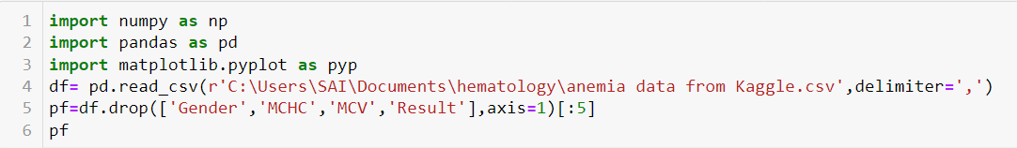
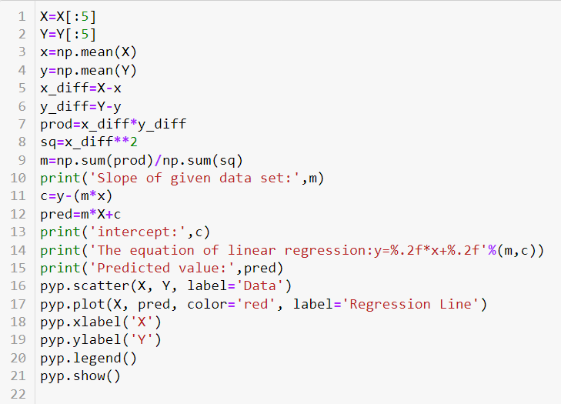
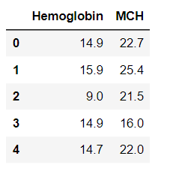
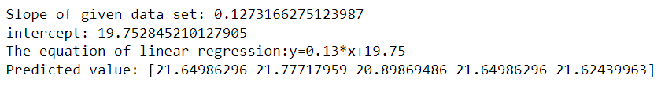
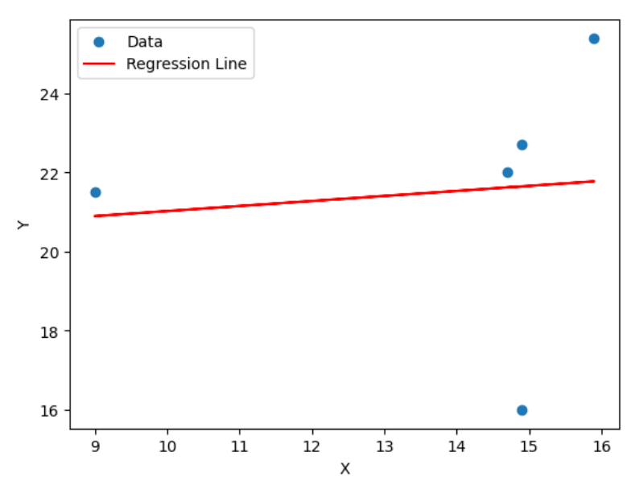


Slide 6
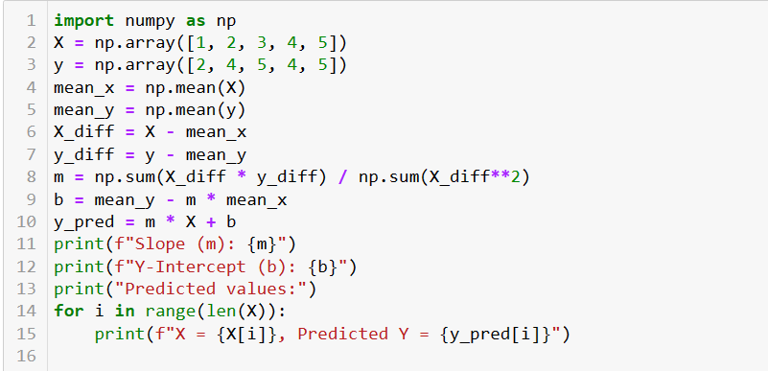
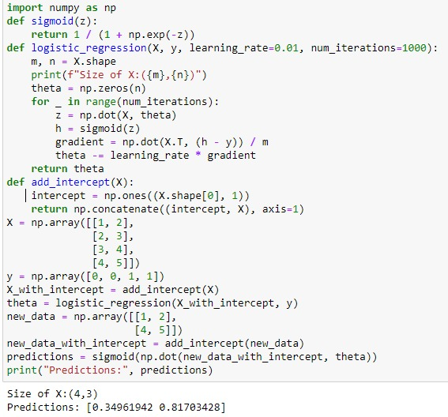
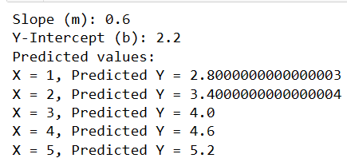

Slide 7
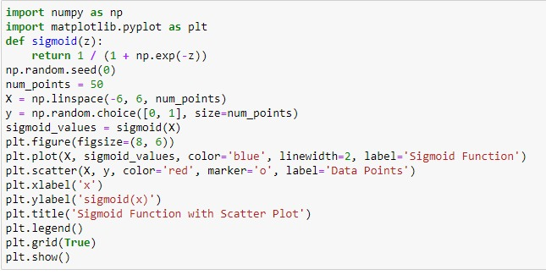
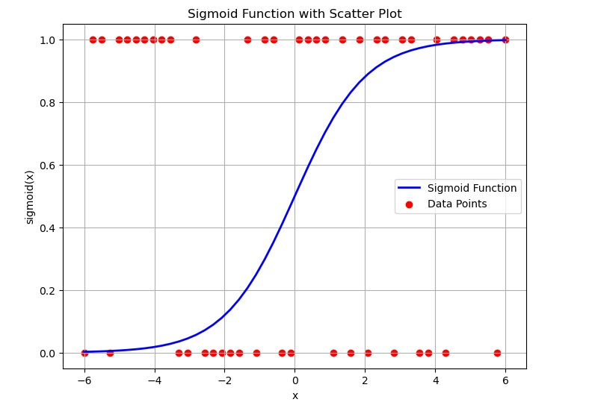
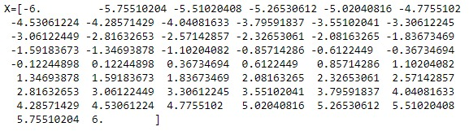

Slide 8
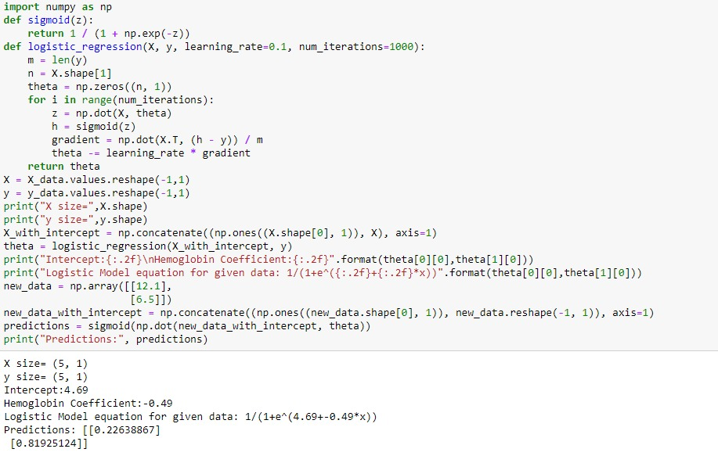
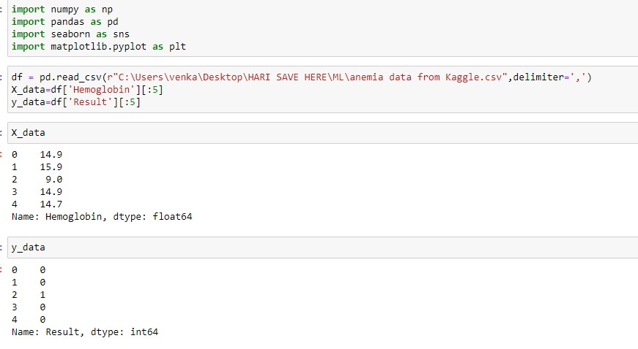
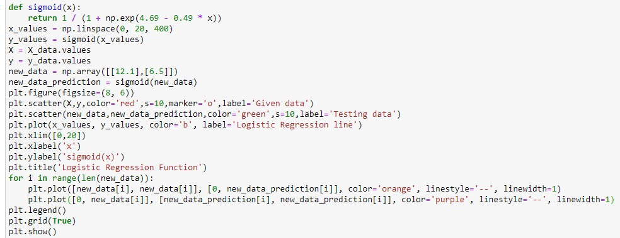

Slide 9
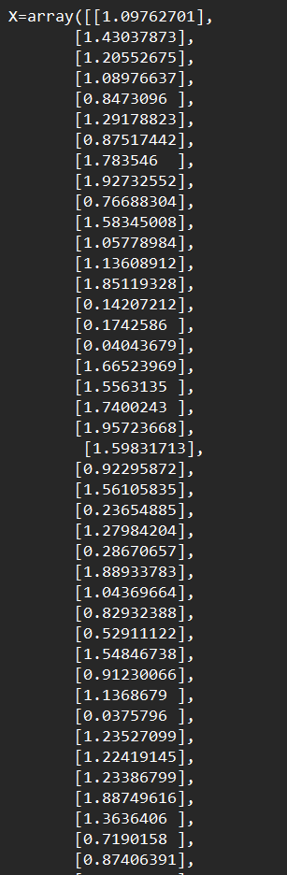
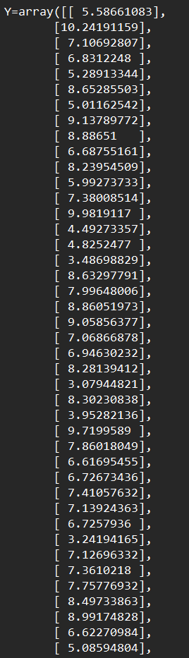
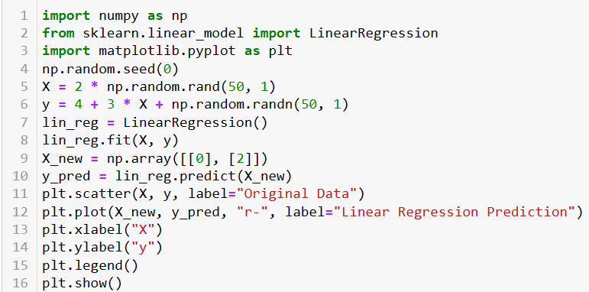
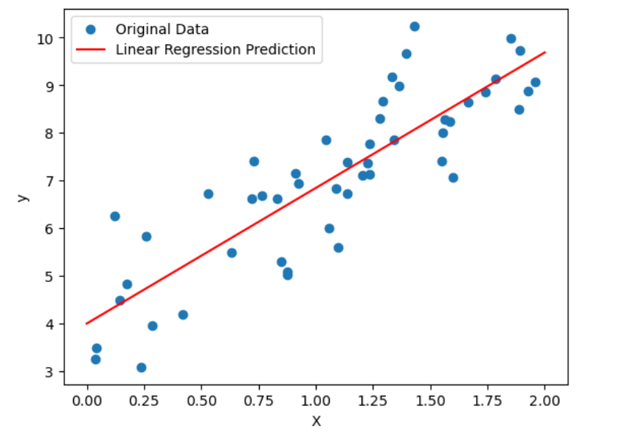

Slide 10
